Slide 1

Case study: Moosic

Slide 2
Business Questions
Are Spotify’s audio features able to identify “similar songs”, as defined by humanly detectable criteria
Is K-Means a good method to create playlists?
Notes:
Imen

Slide 3
Business Questions
Are Spotify’s audio features able to identify “similar songs”, as defined by humanly detectable criteria
Is K-Means a good method to create playlists?
Notes:
Imen

Slide 4
Humanly detectable criteria refer to characteristics of music that can be perceived and interpreted by human listeners.
Rhythm: The pattern of beats, tempo (speed), and rhythmic structure of the music.
Melody: The sequence of notes that form a recognizable tune or theme in the music.
Harmony: The combination of simultaneous sounds, typically chords, that support the melody and contribute to the overall tonal quality of the music.
Timbre: The unique quality or color of sound produced by different instruments or voices, which distinguishes one from another.
Dynamics: The variation in loudness and intensity throughout the music, including crescendos, decrescendos, and changes in volume.
Lyrics: The words or text sung or spoken in the music, if applicable.
Notes:
reference - Imen

Slide 5
Humanly detectable criteria VS Audio features
Human​ | Machine
Rhythm​ | Time_signature​
Melody​ | Valence/Tempo​
Harmony​ | loudness/Instrumentalness​
Timbre​ | Mode​
Dynamics​ | Energy/Danceability​
Lyrics​ | Speechiness/Liveness​
Notes:
Imen

Slide 6
People tend to think about music in terms of genres and eras. Given the features we could work with it, the algorithm is failing completely to group songs by those criteria.
HUMAN
MACHINE
GENRES
MOODS (... ?)
Hip hop, Jazz, Punk, Classical Music, Techno, Heavy Metal, Dub etc…
Ambient electronic landing next to Chopin.
Wagner next to Nena…
ERAS
60s, 70s, 80s, 90s, Renaissance, Baroque etc…
PROVENANCE
French, African, American…
POPULARITY
Hits, hidden gems, B-sides…
Notes:
Martin

Slide 7
People tend to think about music in terms of genres and eras. Given the features we could work with it, the algorithm is failing completely to group songs by those criteria.
HUMAN
MACHINE
GENRES
MOODS (... ?)
Hip hop, Jazz, Punk, Classical Music, Techno, Heavy Metal, Dub etc…
Ambient electronic landing next to Chopin.
Wagner next to Nena…
ERAS
60s, 70s, 80s, 90s, Renaissance, Baroque etc…
PROVENANCE
French, African, American…
POPULARITY
Hits, hidden gems, B-sides…
Notes:
Martin

Slide 8
People tend to think about music in terms of genres and eras. Given the features we could work with it, the algorithm is failing completely to group songs by those criteria.
HUMAN
MACHINE
GENRES
MOODS (... ?)
Hip hop, Jazz, Punk, Classical Music, Techno, Heavy Metal, Dub etc…
Ambient electronic landing next to Chopin.
Wagner next to Nena…
ERAS
60s, 70s, 80s, 90s, Renaissance, Baroque etc…
PROVENANCE
French, African, American…
POPULARITY
Hits, hidden gems, B-sides…
Notes:
Martin

Slide 9
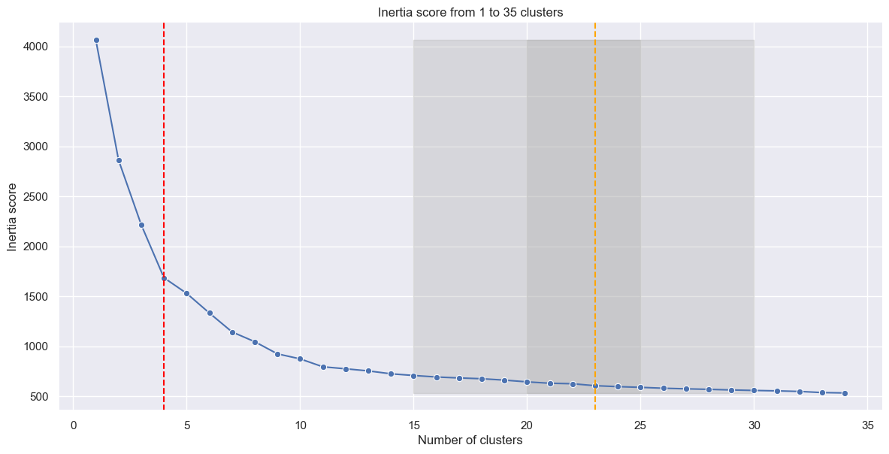
Decide the number of cluster - Inertia
15-30 defined as reasonable number of playlists to split the 5000 songs into
Notes:
Martin. One crucial question was how many playlists, how many cluster do we want to create? We used the inertia analysis with elbow method to decide what is the best number for us. You can see that based on the elbow method, the best number of clusters would be 4. However, our feeling was that we would like to go with something like 15 to 30 different clusters since dividing all the music into just 4 categories would simply not work for the customers.

Slide 10
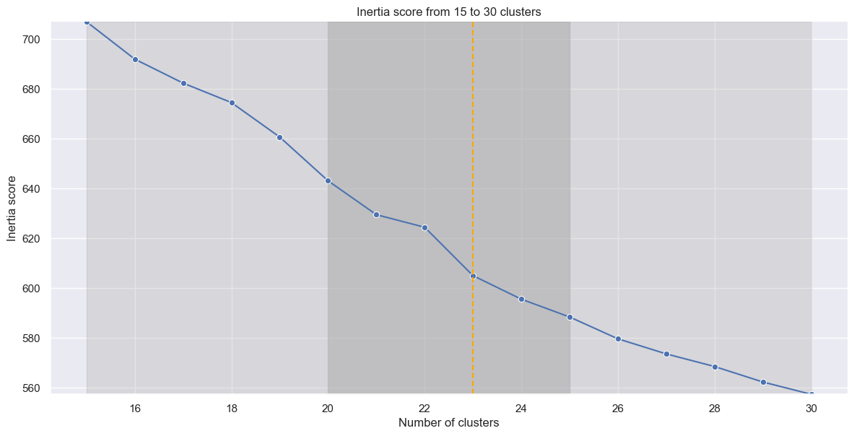
Decide the number of cluster - Inertia
elbow becomes more obvious as we “zoom in”
Notes:
Martin. So as to decide for the right number of clusters, it makes sense to zoom in. Suddenly, another elbow becomes obvious.

Slide 11
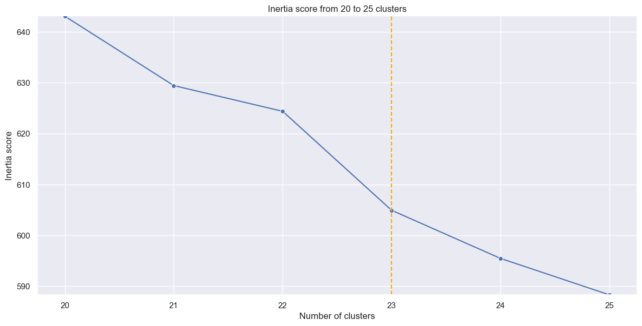
Decide the number of cluster - Inertia
23 is the sweet spot
Notes:
Martin. As you can see here, 23 is the sweet spot in our predefined range.

Slide 12
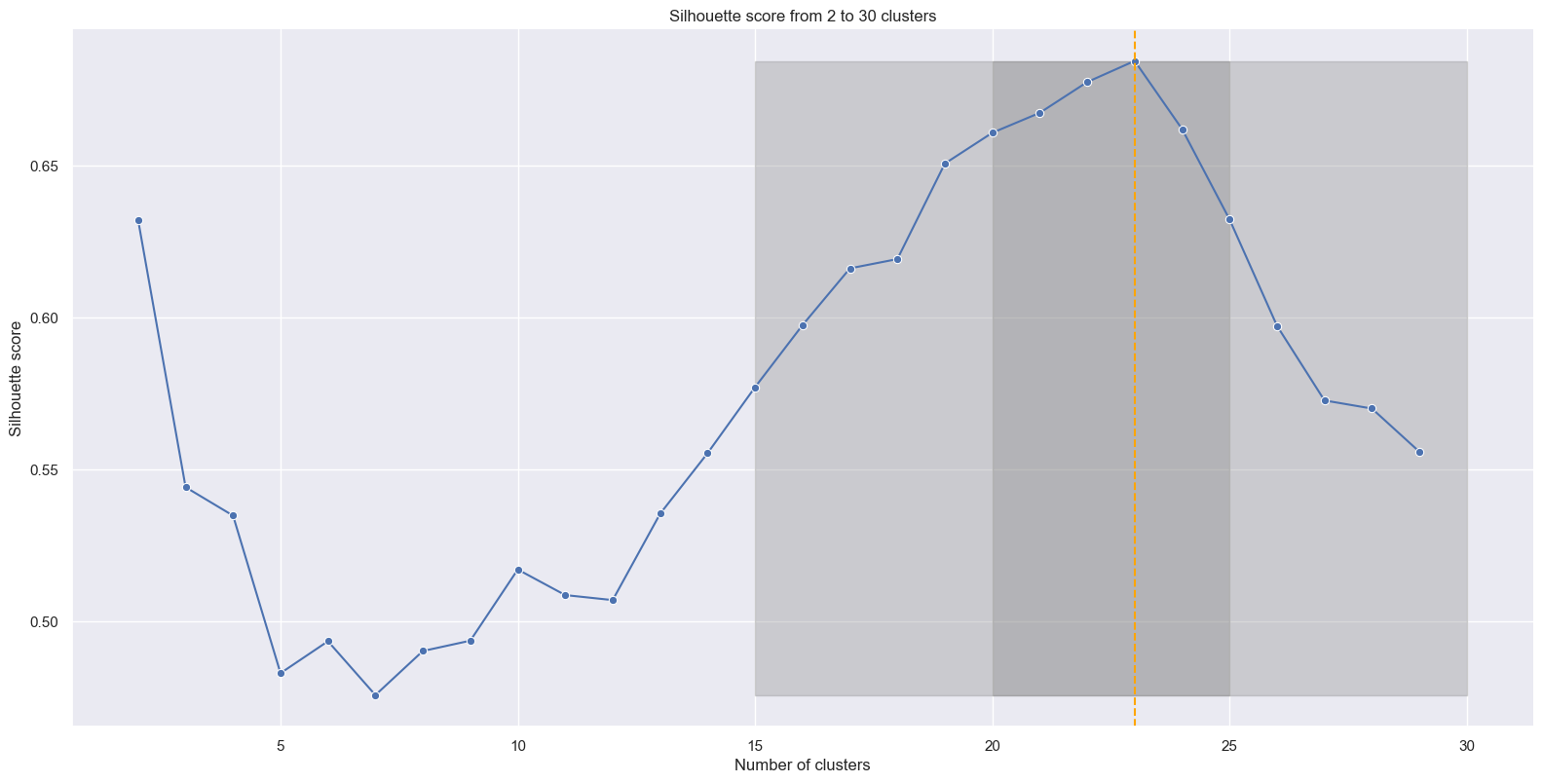
Decide the number of cluster - Silhouette score
23 is the sweet spot
Notes:
Martin. Also the Silhouette score for 23 confirms 23 is a great number of clusters to go for.

Slide 13
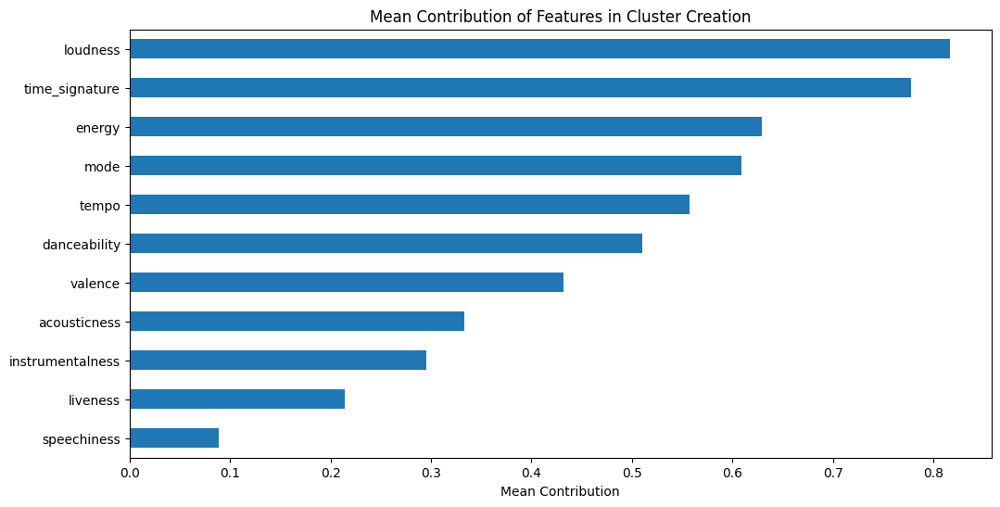
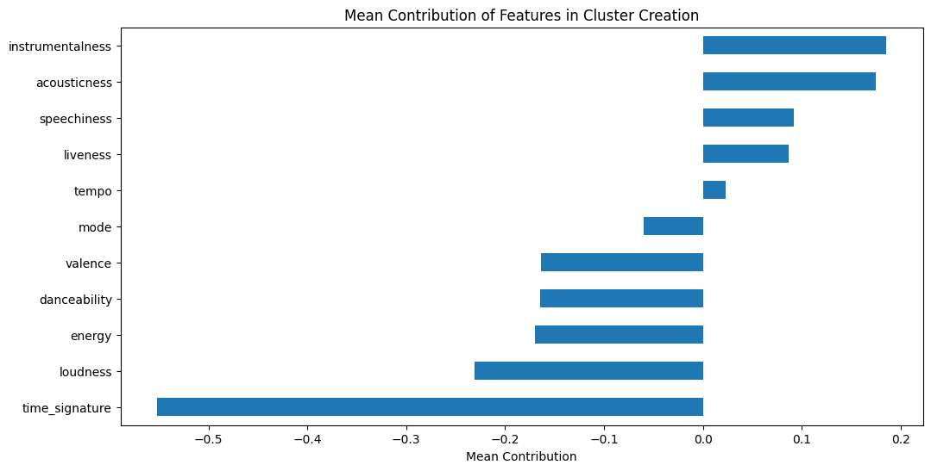
maxminscaler
features contributing to each cluster
standard scaler
Notes:
Lawrence

Slide 14
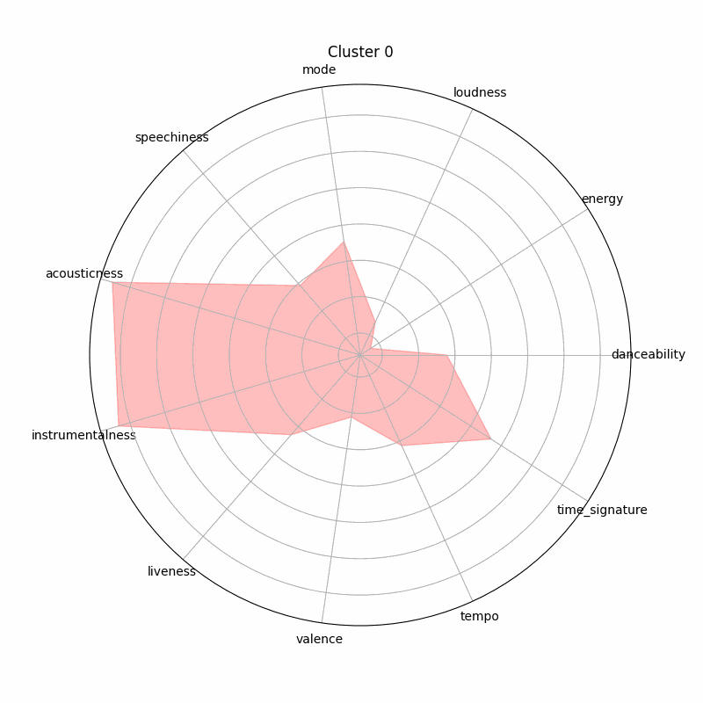
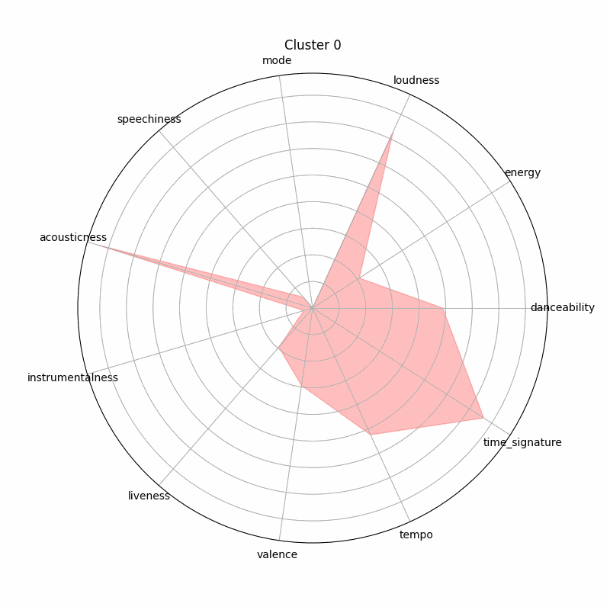
maxminscaler
features contributing to each cluster
standard scaler
Notes:
Lawrence
for this project we consider maxmin

Slide 15
Naming the playlists
workout music
gangsta disco
calm down and chill
hard metal
Notes:
Imen

Slide 16
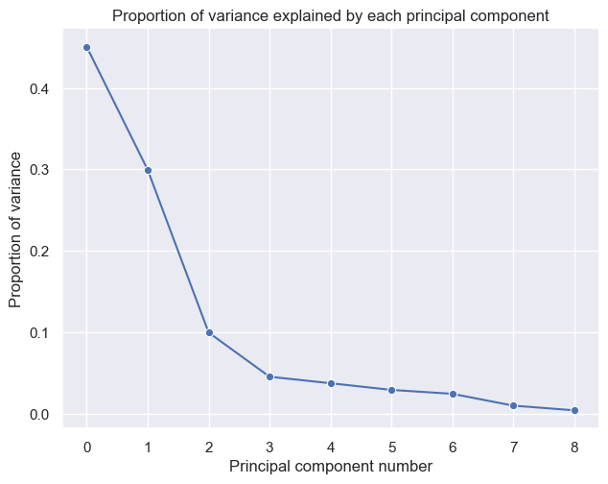
Impact of principal components
For PCA5,
96.2 % variance is covered
Notes:
Sam

Slide 17
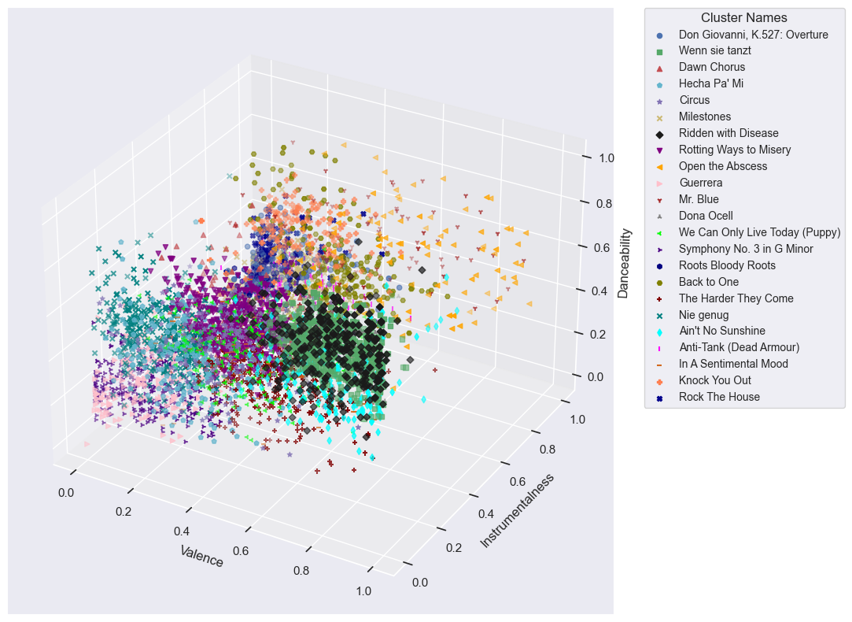
Top 3 features in clusters
With 96.2% variance,
top features contributions are:
Valence
Instrumentalness
Danceability
Notes:
Sam

Slide 18
Conclusion
Nine audio features
MinMax scaling
PCA Analysis - 5 principal components covers 96% variance
K-means model - 23 clusters
i– Spotify’s audio features are able to identify “similar songs” to some extent, but fail to distinguish between genres and eras
ii- K-Means is a good method to create playlists. However, it would make sense to use it on pre-categorized data (e.g. including year of creation, genre, degree of popularity). Another downside is that it is splitting the dataset. One song cannot appear in more than one playlist.
Notes:
Sam

Slide 19
appendix/archive

Slide 20
other clustering method
DBSCAN (Density-Based Spatial Clustering of Applications with Noise)
Gaussian Mixture Models (GMM)
Alternatives like DBSCAN offer advantages such as handling arbitrary cluster shapes and sizes based on data density, while hierarchical clustering provides a hierarchical structure of clusters. The choice depends on the data's characteristics and clustering goals

Slide 21
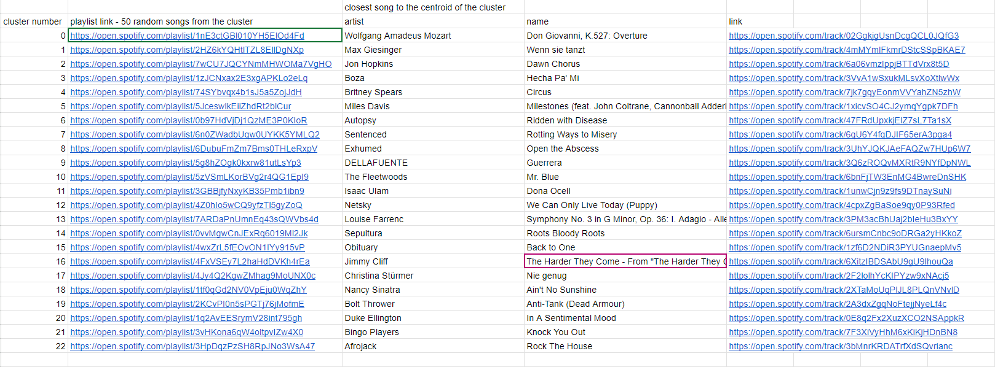

Slide 22
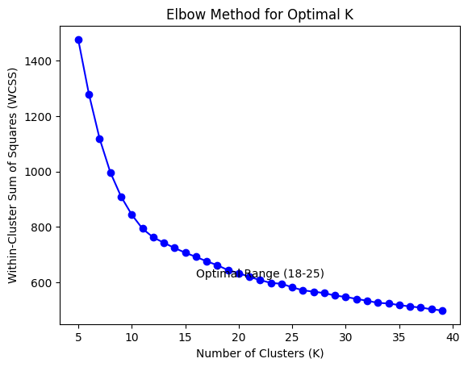
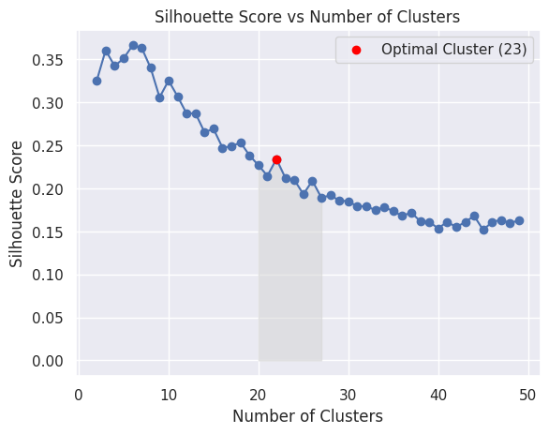
Decide the number of cluster
K= 23

Slide 23
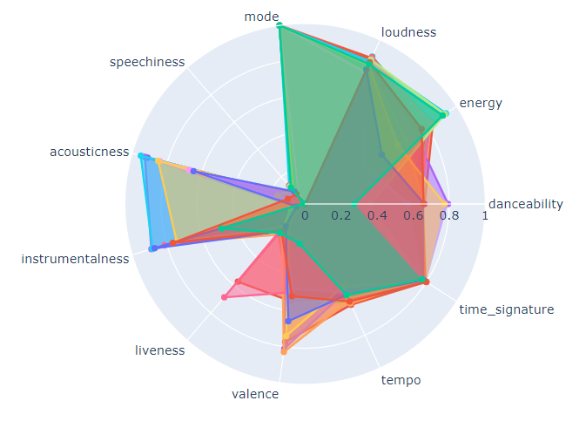
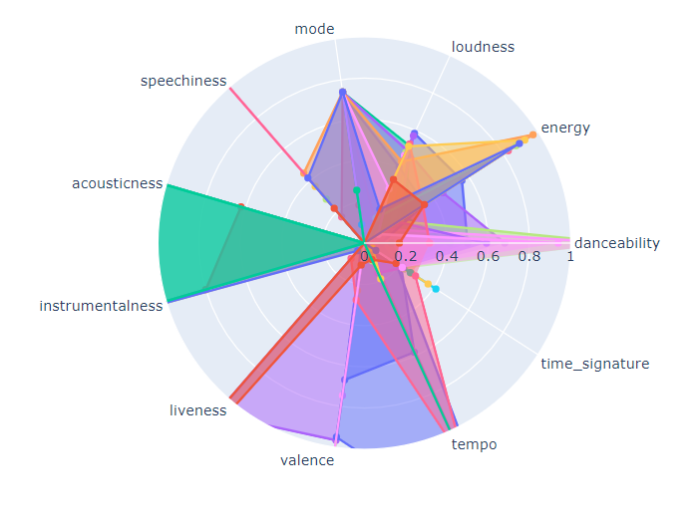
standard scaler
maxminscaler

Slide 24
K-means efficiently categorizes songs into clusters based on their features, providing clear distinctions between different groups. Its simplicity and speed make it a practical choice for organizing songs into distinct categories.

Slide 25
things to consider
Introduction Imen
1- IMPORTING DATA AND SELECTING DESIRED FEATURES Imen
2- SCALING AND TRANSFORMATION minmax IMEN
3- NUMBER OF CLUSTERS- 23 IMEN
4- PCA- 2
5- KMEANS MODEL SAM
6- CONCLUSION SAM
i– Are Spotify’s audio features able to identify “similar songs”, as defined by humanly detectable criteria?
ii- Is K-Means a good method to create playlists?

